Slide 1
Chapter 5: Language
Professor Gonzalez

Slide 2
The Nature of Language
What is language?
-a way to represent or symbolize our feelings.
- it is symbolic
-mostly arbitrary
-has meaning

Slide 3
The Nature of Language
Language
-A structured system of symbols used for communicating meaning.
Which side of the brain do we use when using as well as learning language?
A: Left
-used for generating words, hearing words, seeing words, and speaking words.
Are written words verbal words?

Slide 4
The Nature of Language
Language is symbolic
-each word represents a particular object or idea.
What does the word “mason” represent?
-could be an actual craftsman or a member of a fraternity.
What does the word “carriage” represent?
-could be an actual carriage used by a horse as well as a piece of a car.

Slide 5
The Nature of Language
Words literally mean whatever we, as users of a language, choose for them to mean.
Language can be arbitrary precisely because it is symbolic.
Are there exceptions to this rule?
Onomatopoeia-
A word formed by imitating the sound associated with its meaning.
-buzz, meow, splash, click, etc…

Slide 6
The Nature of Language
Language Is Governed by Rules
There are 4 rules:
1. Phonological rules- deal with the correct pronunciation of words.
2. Syntactic rules- govern the ordering of words within phrases.
3. Semantic rules- have to do with the meaning of individual words.
4. Pragmatic Rules- deal with the implications or interpretations of statements.

Slide 7
The Nature of Language
Language has layers of meaning.
Denotative and connotative meaning.
Denotative meaning- A word’s literal meaning or dictionary definition.
Connotative meaning- A word’s implied or secondary meaning, in addition to its literal meaning.

Slide 8
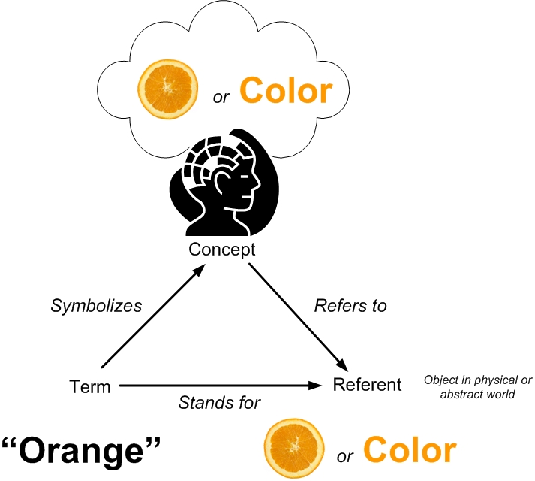
The Nature of Language-Semantic Triangle
Semantic Triangle- portrays 3 necessary elements for identifying the meaning in language.
Symbol- the word being communicated
Referent- the word’s denotative meaning.
Reference- the word’s connotative meaning.
Ogden & Richards

Slide 9
The Nature of Language
We need to “bail out” the auto industry.
We need to develop a “rescue plan” for the auto industry.
These are examples of “loaded language”
Loaded language- Terms that carry strongly positive or negative connotations.
Loaded language reflects the observation that denotations and connotations represent different layers of meaning.

Slide 10
The Nature of Language
Language Varies in Clarity
Is the right bolt the right bolt to turn?
Right, turn the right bolt counterclockwise.
Ambiguous language- Language having more than one possible meaning.
According to the OED- 500 most frequently used words have an average of 23 meanings.
OED= Oxford English Dictionary

Slide 11
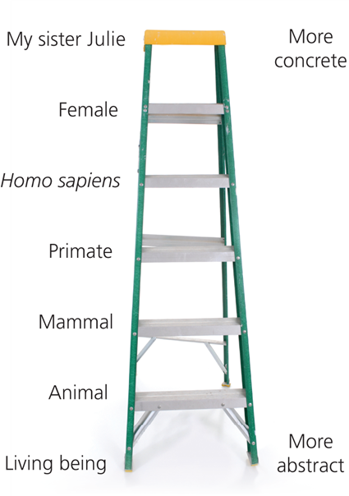
The Nature of Language
Why does language vary in clarity?
Some words are more concrete than others.
Concrete- refers to a specific object in the physical world.
Abstract- refers to a broader category or organizing concept of objects.

Slide 12
The Nature of Language
Meaning in language is affected by?
Social and cultural context in which we use it.
Individualistic vs. Collectivist culture
Individualistic- “I am looking out for number one” “I am looking out for me”
Collectivist- “It is the nail that sticks out that gets hammered down” “

Slide 13
The Nature of Language
Sapir-Whorf hypothesis- The idea that language influences the ways that members of a culture see and think about the world.
2 specific principles.
1. Linguistic determinism- suggests that the structure of langue determines how we think.
2. Linguistic relativity- suggests that because language determines our perceptions of reality, people who speak different languages will see the world differently.

Slide 14
The POWER of Words
Rudyard Kipling- words “the most powerful drug used by mankind”
5 Important Contexts of Words
1. Naming
2. Persuasion
3. Credibility and Power
4. Affection
5. Comfort

Slide 15
The Power of Words
Naming and Identity
-suggests information about a person’s demographic characteristics
-provide clues about a person’s ethnicity
-we do make assumptions accurately or not on the basis of an individuals name.

Slide 16
The power of words
We use words to persuade
Persuasion
- the process of moving people to think or act in a certain way.
Aristotle- 3 forms of rhetorical proof
1. Ethos
2. Pathos
3. Logos

Slide 17
The power of words
Ethos
- A speaker’s respectability, trustworthiness, and moral character.
-the more respectable and trustworthy you seem the better able you are to persuade someone.
-good persuasive speakers establish and reinforce their credibility with their audience.

Slide 18
The power of words
Pathos
- Listener’s emotions
We appeal to negative emotions when we want to change someone’s behavior.
Ad Council appeals to fear, guilt, disgust, anger, and sadness to change an individual's drug use.
Why would an appeal to negative emotion work better than an appeal to positive emotion?

Slide 19
The power of words
Logos
- Listener’s ability to reason
Reason- To make judgments about the world based on evidence rather than emotion or intuition.
Does the media tend to use pathos or logos more?

Slide 20
The power of words
Credibility empowers us
Credibility
- The extent to which others find someone’s words and actions trustworthy.
Why does credibility matter?
Is language tied to credibility?
What can affect our credibility?
1. Clichés
2. Dialects
3. Equivocation

Slide 21
The power of words
Clichés- phrases that were novel at one time but have lost their effect because of overuse.
-politicians and businesspeople
Dialects- variations on a language that are shared by people of a certain region or social class.
Communication Accommodation Theory-suggests that if we speak in a dialect familiar to our audience we can enhance our credibility.
Ex. The pronunciation of a state name in a certain geographic reason of the state.

Slide 22
The power of words
Equivocation
- language that disguises the speaker’s true intentions through strategic ambiguity.
-used when we are all out of options.
-when faced with two unappealing choices we will use equivocal language to remove ourselves from the situation.
Do men or women use more equivocal language?
-studies suggest women use equivocal language more than men.
Why?

Slide 23
The power of words
Weasel words
- terms and phrases that are intended to mislead listeners by implying something that they don’t actually say.
“People say that…”
“It’s widely known that…”
“They say…”
Allness statements
- A declaration implying that a claim is true without exception.
“Experts agree…” “Research suggests….”

Slide 24
The power of words
Choosing credible language
Instead of saying “they say” use “I believe”
Once you lose credibility it is difficult to get it back.

Slide 25
The Use and Abuse of Language
Humor
-contains one aspect of communication and that is a violation of our expectations.
-the most important part of humor
Euphemism
- A vague, mild expression, that symbolizes something more blunt or harsh.
Examples: Let go, sleep together, praying at the porcelain altar.
-We use euphemisms to sound less harsh or explicit
-embarrassed
-offended

Slide 26
The Use and Abuse of Language
PTSD- “shell shock”, “battle fatigue”, “operation exhaustion”
Doublespeak
- euphemisms are used specifically to disguise or distort meaning.
-may increase our ability to tolerate some situations.

Slide 27
The Use and Abuse of Language
Slang
- Informal, unconventional words that are often understood only by others in a particular subculture.
-used in our subcultures such as work or with certain friends.
-people who do not know the particular slang of a subculture may feel excluded.

Slide 28
The Use and Abuse of Language
Defamation
- Language that harms a person’s reputation or image.
2 Forms
Libel- A defamatory statement made in print or in some other fixed medium.
Slander- A defamatory statement made aloud.
When can a true accusation qualify as slander or libel?
A: Usually involves a public figure and serves no prevailing public interest.

Slide 29
The Use and Abuse of Language
Profanity
- A form of language considered vulgar, rude, or obscene in the context in which it is used.
When you lower or eliminate the shock value of a word you are…
Reclaiming the term
Use of profanity also acts as a…
Social Lubricant- maintains an informal atmosphere.

Slide 30
The Use and Abuse of Language
Hate Speech
- A form of profanity meant to degrade, intimidate, dehumanize groups of people.
-gender, national origin, sexual orientation, religion, race, disability status, or political or moral views
-when you degrade any of the above it is a form of hate speech
U.S. States with Hate Crime Laws- All states except Wyoming, Arkansas, Indiana, South Carolina, and Georgia

Slide 31
The Use and Abuse of Language
Do you feel that restricting speech is a form of censorship and a violation of the First Amendment of the United States Constitution?

Slide 32
Improving Your Language Use
Consider the Effect You Wish to Create
What do you want your words to accomplish?
-Comfort
-Inform
-Entertain
3 Basic Mistakes
1. Shared Knowledge Errors
2. Shared Opinion Errors
3. Monopolization Errors

Slide 33
Improving Your Language Use
Shared knowledge error-
presume your listeners have information that they don’t have.
-acquaintances and strangers may not know what you are talking about
Shared Opinion Error-
when you incorrectly assume that your listeners share your opinions.
-assume everyone present agrees with you
-can offend those who do not share your beliefs

Slide 34
Improving Your Language Use
Monopolization Error-
when one speaker inappropriately dominates the conversations.
-you do most of the talking and do not give the other person a chance
-give and take is important
-ideas
-opinions
-comments
Push talking-
dominating the conversation and continually interrupting an individual.

Slide 35
Improving Your Language Use
Separate Opinions from Factual Claims
Factual Claim
- it is either true or false
Opinion
- expresses a personal judgment or preference that we could agree or disagree with, but that is not true or false in an absolute sense.

Slide 36
Improving Your Language Use
Opinions are opinions whether you agree with them or not- express “what should be”
Factual claims are factual claims whether they are true or not- can be verified by evidence.
When you feel more strongly about an issue, the more one tends to think of our beliefs as facts rather than opinions.

Slide 37
Improving Your Language Use
Speak at an appropriate level
-complex language should be used only with those who can understand it.
Examples:
The ANOVA tells us that the population mean is not equal due to the Z score probability ranking.
I utilized K-Nearest neighbors to determine the relationship between the latent variables.
Utilizing 4 nodes on the decision tree I was able to determine the significance of…….

Slide 38
Improving Your Language Use
I-statement-
A statement that claims ownership of one’s thoughts or feelings.
-do not ignore the problem
-allows one to take ownership
You-statement-
A statement that shifts responsibility for one’s own thoughts or feelings to the listener.
-can cause a listener to become defensive
The use of I-statements rather than You-statements

